Slide 1
إدارة المشروعات Projects Management
د. باسم ممدوح الحلوانى
Lecture 7
Time Management
Part 3

Slide 2
P5: Developing the Schedule
Practical Considerations for Developing the Schedule
Calendar Dates
Use Network Information
Extended Network Techniques to Come Close to Reality
Avoid Dangler Paths
Dummy tasks

Slide 3
P5: Developing the Schedule
Practical Considerations for Developing the Schedule
Calendar Dates
Week end days and
National and International holidays must be considered carefully

Slide 4
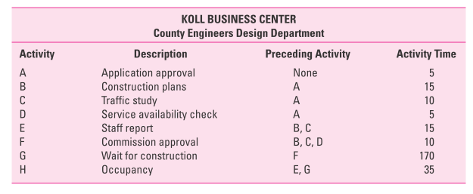
Practical Considerations for Developing the Schedule
Network Information
In case you do not have the start and end nodes, you must consider all available information to build the network diagram

Slide 5
P5: Developing the Schedule
Practical Considerations for Developing the Schedule
Extended Network Techniques to Come Close to Reality
Laddering
Activities are broken into segments (especially long activities) so the following activity can begin sooner and not delay the work.
Lags
The minimum amount of time a dependent activity must be delayed to begin or end.
Lags can be used with finish-to-start, start-to-start, finish-to-finish, start-to-finish, or combination relationships.

Slide 6
P5: Developing the Schedule
Practical Considerations for Developing the Schedule
Extended Network Techniques to Come Close to Reality
Example of Laddering Using Finish-to-Start Relationship

Slide 7
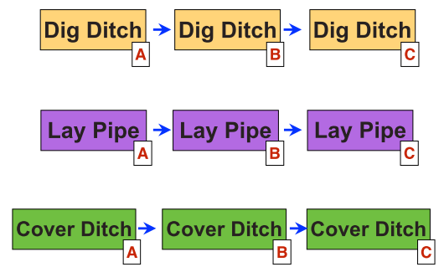
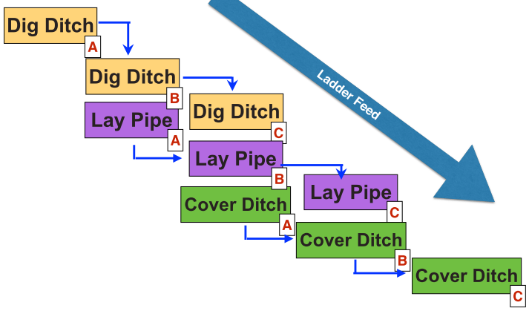
Practical Considerations for Developing the Schedule
Extended Network Techniques to Come Close to Reality
Example of Laddering Using Finish-to-Start Relationship

Slide 8
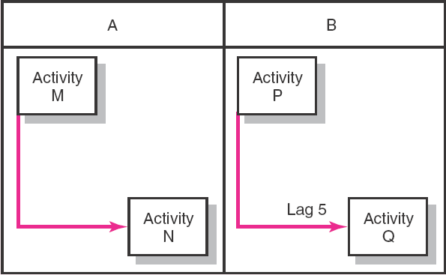
P5: Developing the Schedule
Practical Considerations for Developing the Schedule
Extended Network Techniques to Come Close to Reality
Start-to-Start Relationship

Slide 9
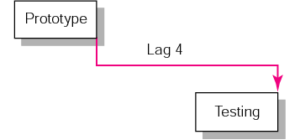
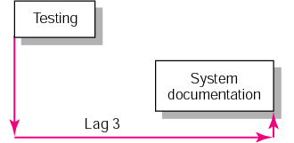
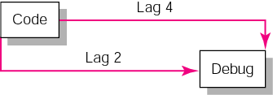
Practical Considerations for Developing the Schedule
Extended Network Techniques to Come Close to Reality
Finish-to-Finish Relationship
Start-to-Finish Relationship
Combination Relationship

Slide 10
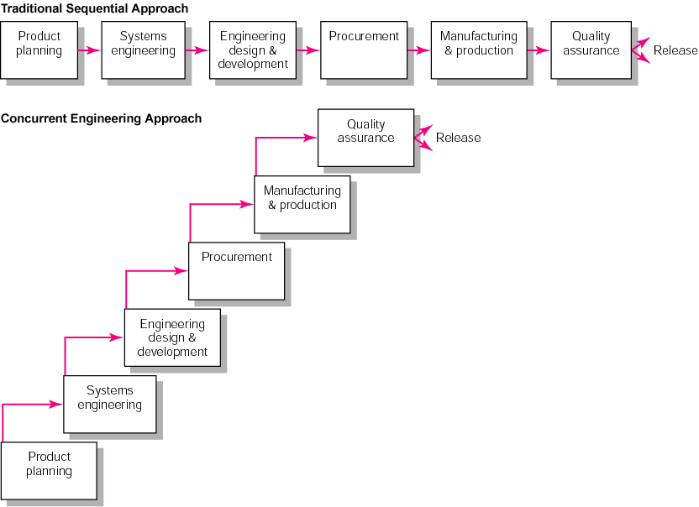
New Product Development Process
Practical Considerations for Developing the Schedule
Extended Network Techniques to Come Close to Reality

Slide 11
Practical Considerations for Developing the Schedule
Avoid Dangler Paths
If a project has more than one activity that can begin when the project is to start, or multiple activity at the end ,each path is a dangler path.
Even if this is not a requirement, it is a good idea because it avoids “dangler” paths. Dangler paths give the impression that the project does not have a clear beginning or ending.
Danglers can be avoided by tying dangler activities to a common project start or finish node.

Slide 12
Practical Considerations for Developing the Schedule
Dummy activities
Rule: two or more activities cannot share same start and end nodes
Then, How to represent concurrent activities?
3
Lay foundation
Lay
foundation
Dummy
2
3
2
0
1
2
4
Order material
Order material
(a) Incorrect precedence relationship
(b) Correct precedence relationship

Slide 13
Practical Considerations for Developing the Schedule
Dummy activities
B
1
A
2
3
D
4
Task D has immediate predecessors of B and C
C
Tasks B and C have the same start and finish nodes
A
B
D
1
2
3
5
C
A new node is inserted to give C a different finish node to B
A dummy task is inserted to preserve the immediate predecessors of D
4

Slide 14
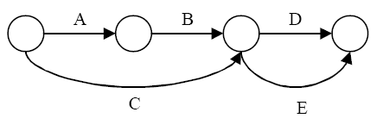
Practical Considerations for Developing the Schedule
Dummy activities
Case 2:
Ending node of task B and C, but task C has a precedence ONLY task C
Wrong Diagram
Task D and E have same start and end nodes

Slide 15
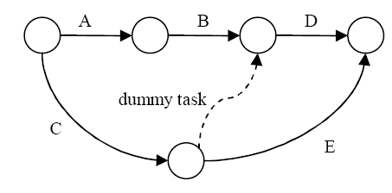
Practical Considerations for Developing the Schedule
Dummy activities
Case 2:
Correct Diagram

Slide 16
P5: Developing the Schedule
Critical Path Method (CPM):
CPM (or critical path analysis) is a network diagramming technique used to predict total project duration
A critical path for a project is the series of activities that determines the earliest time by which the project can be completed
The critical path is the longest path through the network diagram and has the least amount of slack or float
Slack or float is the amount of time an activity may be delayed without delaying a succeeding activity or the project finish date

Slide 17
P5: Developing the Schedule
Calculating the Critical Path
First develop a good network diagram
Add the duration estimates for all activities on each path through the network diagram
The longest path is the critical path
If one or more of the activities on the critical path takes longer than planned, the whole project schedule will slip
unless the project manager takes corrective action
Project Time Management

Slide 18
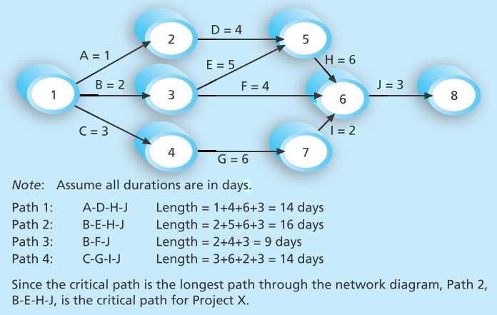
P5: Developing the Schedule
Calculating the Critical Path
There can be more than one critical path if the lengths of two or more paths are the same
The critical path can change as the project progresses
Project Time Management

Slide 19
P5: Developing the Schedule
Using Critical Path Analysis to Make Schedule Trade-offs:
It is important to know the critical path throughout the life of a project so the product manager can make trade-offs.
If a task on the critical path is behind schedule, the project manager must be aware of the problem and decide what to do about it.
Should the schedule be renegotiated with stakeholders?
Should more resources be allocated to other items on the critical path to make up for that time?
Is it acceptable for the project to finish behind schedule?
A technique that can help project managers make schedule trade-offs is determining the free slack for each project activity.
Project Time Management

Slide 20
P5: Developing the Schedule
Using Critical Path Analysis to Make Schedule Trade-offs:
Free slack (or free float) is the amount of time an activity can be delayed without delaying the early start of any immediately following activities
Or Is how long an activity can exceed its early finish date without affecting early start dates of any successor(s).
Project managers calculate free slack by doing a forward and backward pass through a network diagram.
Project Time Management

Slide 21
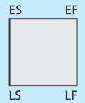
P5: Developing the Schedule
Using Critical Path Analysis to Make Schedule Trade-offs:
A forward pass through the network diagram determines the early start (ES) and early finish (EF) dates
A backward pass determines the late start (LS) and late finish (LF).
The early start (ES) date is the earliest possible time an activity can start based on the project network logic
The early finish (EF) date is the earliest possible time an activity can finish based on the project network logic.
The late start (LS) date is the latest possible time an activity might begin without delaying the project finish date.
The late finish (LF) date is the latest possible time an activity can be completed without delaying the project finish date.
Project Time Management

Slide 22
Node Configuration
In the nodes, the activity time and the early and late start and finish times are represented in the following manner
Earliest start
Earliest finish
Activity number
1
0
3
ACTIVITY t
ES EF
LS LF
3
0
3
Activity duration
Latest start
Latest finish
Earliest times are computed as
Earliest finish time = Earliest start time + Expected activity time
EF = ES + t
Earliest start time (ES) = Largest EF of immediate predecessors

Slide 23
P5: Developing the Schedule
At the start of the project we set the time to zero
Thus ES = 0 for both A and B
A t = 2
ES = 0 EF = 0 + 2 = 2
Start
B t = 3
ES = 0 EF = 0 + 3 = 3

Slide 24
P5: Developing the Schedule
Forward Pass
EF = ES + t
ES = Largest EF of immediate predecessors
A 2
0 2
C 2
2 4
F 3
4 7
E 4
4 8
H 2
13 15
Start
Finish
B 3
0 3
D 4
3 7
G 5
8 13
Project Time Management

Slide 25
P5: Developing the Schedule
Latest times are computed as:
Latest start time = Latest finish time – Expected activity time
LS = LF – t
Latest finish time (LF) = Smallest LS of following activities
For activity H
LS = LF – t = 15 – 2 = 13 weeks
Project Time Management

Slide 26
P5: Developing the Schedule
Backward Pass
Latest times are computed as:
LF = Smallest LS of following activities
A 2
0 2
0 2
C 2
2 4
2 4
F 3
4 7
10 13
Only 1 following activity
E 4
4 8
4 8
H 2
13 15
13 15
Start
Finish
B 3
0 3
1 4
D 4
3 7
4 8
G 5
8 13
8 13
LS = LF – t
No following
Activities (End) EF = LF

Slide 27
P5: Developing the Schedule
Slack Time:
Once ES, LS, EF, and LF have been determined, it is a simple matter to find the amount of slack time that each activity has
Slack = LS – ES, or Slack = LF – EF
 | EARLIEST START, ES | EARLIEST FINISH, EF | LATEST START, LS | LATEST FINISH, LF | SLACK, LS – ES | ON CRITICAL PATH?
A | 0 | 2 | 0 | 2 | 0 | Yes
B | 0 | 3 | 1 | 4 | 1 | No
C | 2 | 4 | 2 | 4 | 0 | Yes
D | 3 | 7 | 4 | 8 | 1 | No
E | 4 | 8 | 4 | 8 | 0 | Yes
F | 4 | 7 | 10 | 13 | 6 | No
G | 8 | 13 | 8 | 13 | 0 | Yes
H | 13 | 15 | 13 | 15 | 0 | Yes
ACTIVITY

Slide 28
P5: Developing the Schedule
Slack Time:
From Table, we see activities A, C, E, G, and H have no slack time
These are called critical activities and they are said to be on the critical path
The total project completion time is 15 weeks
Industrial managers call this a boundary timetable
A 2
0 2
0 2
C 2
2 4
2 4
F 3
4 7
10 13
E 4
4 8
4 8
H 2
13 15
13 15
Start
Finish
B 3
0 3
1 4
D 4
3 7
4 8
G 5
8 13
8 13
Project Time Management

